Slide 1
Spine & Story
Narrative Structure in Writing & Rewriting
Peggy Riley. 22 October 2016

Slide 2
Spine & Story
  Not everyone agrees what a story is:
  “Plot is the route you take; story is the journey you make.”
      Paul Ashton, BBC Writers’ Room
  “Story is the material of a book’s events and characters – what happens. The narrative is how the story is told.”
      John Mullen: How Novels Work

Slide 3
What do we mean by structure?
  Structure is how you draw the map & how you build the road, to get you from plot point to plot point – so that the reader will get to the end of the story. It is the sense of design that convinces.
It displays how the telling of a story has been arranged by the author – particularly when it is complicated.
Structure can show readers how the story will work on the page.

Slide 4
Structure as Design
How do we structure work for readers?
Chapter Headings: for location in time/space or to name an idea
Devices: Epistolary novels: letters, diaries, news clippings, blogs, emails: Dracula/Possession/Bridget Jones Diary/Where’d You Go, Bernadette
Objects/Art, etc.: Notes From an Exhibition, Station Eleven
Lists/Inset writing/Power Points, etc.: Visit by the Goon Squad
Sections divided by strict chronology: time/place/season or character:
  Barbara Kingsolver’s The Poisonwood Bible

Slide 5
Structure & Narrative
  We also structure the narrative – the narrative arc that is the characters’ journey:
  This ”road” we build is the narrative arc. The stronger the drive behind the protagonists’ actions – the stronger the narrative drive – what propels them forward also pulls the reader along to know – what happens next?
  The best structure is one that takes the best route to INCREASE the drive.
The drive goes forward – but the plot and story and structure might not.
Whether we’re writing and rewriting – it is easy to lose our way.

Slide 6
Structure as Design
Linear: A to B to C: simple or complicated journey
  How many narratives? 2? 3? A montage?
  How many points of view/times/locations?
Reverse: Memento/Time’s Arrow/ Paluanuik’s Survivor (pages backward)
Circle: start at beginning:
  Beginning as end: The “same” but changed: Hero’s Journey
  Start at end – story as “flashback” to understand what ending “means”
The Flashforward:
  Start at point of climax or crisis - jump to beginning (loop) – or fill in backstory (feathers)
Framing/Story within a Story: Life of Pi/Atonement
“My Structure: Linear & Reverse, intercut

Slide 7
Spine & Story
So…
How do you decide what the road map should look like? And where it should go?
How do you design a road that will take your characters on this journey – and not collapse halfway along?
How do you build it?

Slide 8
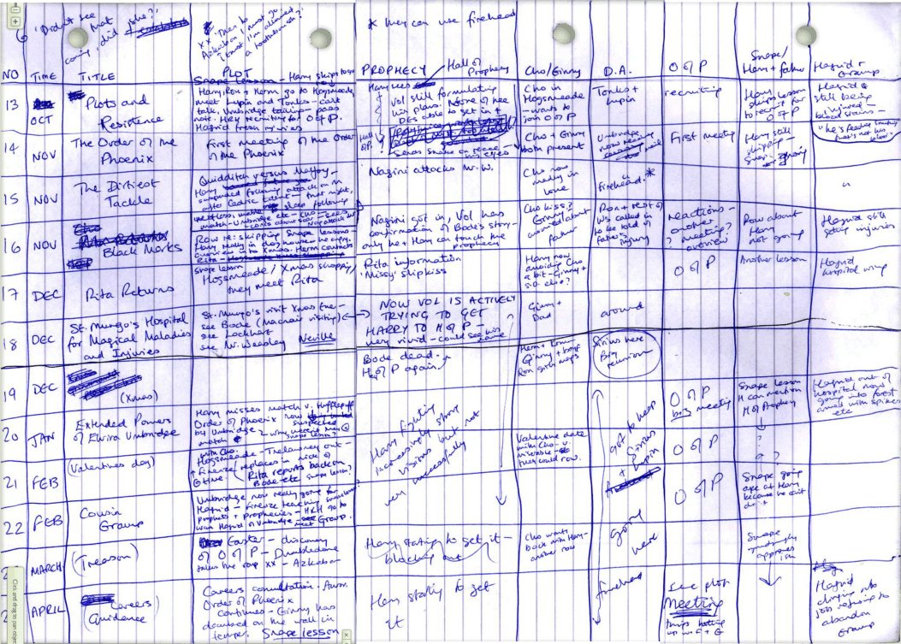
How much do you have to know in advance?

Slide 9
What is the spine of the story?
Once upon a time there was ___. Every day, ___. One day ___. Because of that, ___. Because of that, ___. Until finally ___. And ever since that day _____.
        Pixar, on Storytelling
        Rule 4 of Emma Coats: Pixars’ 22 Rules of Storytelling: http://www.aerogrammestudio.com/2013/03/07/pixars-22-rules-of-storytelling/

Slide 10
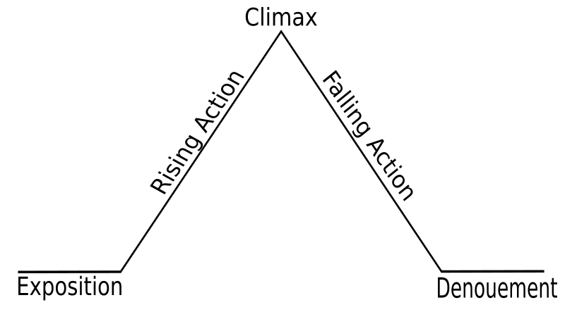
Gustav Freytag: Freytag’s Pyramid, 1863

Slide 11
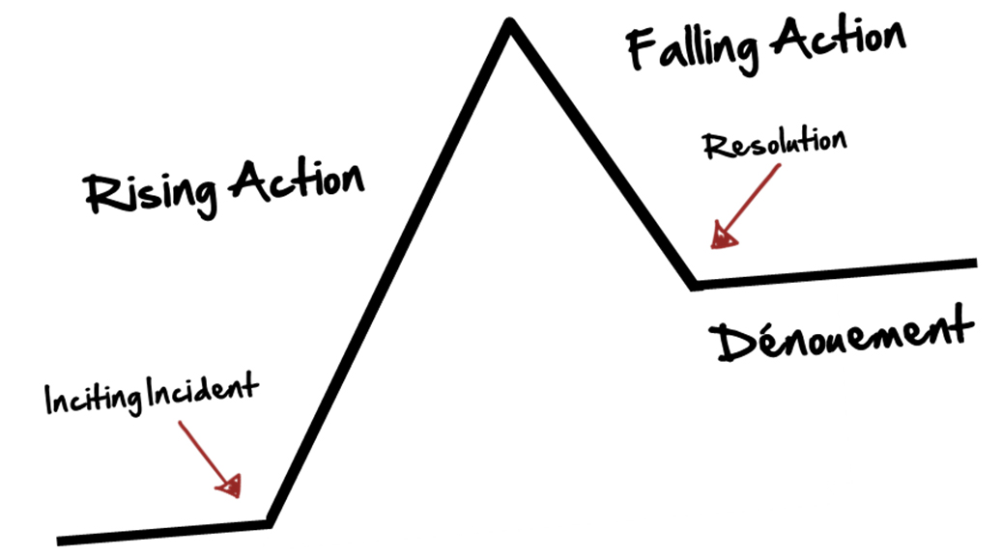
An update

Slide 12
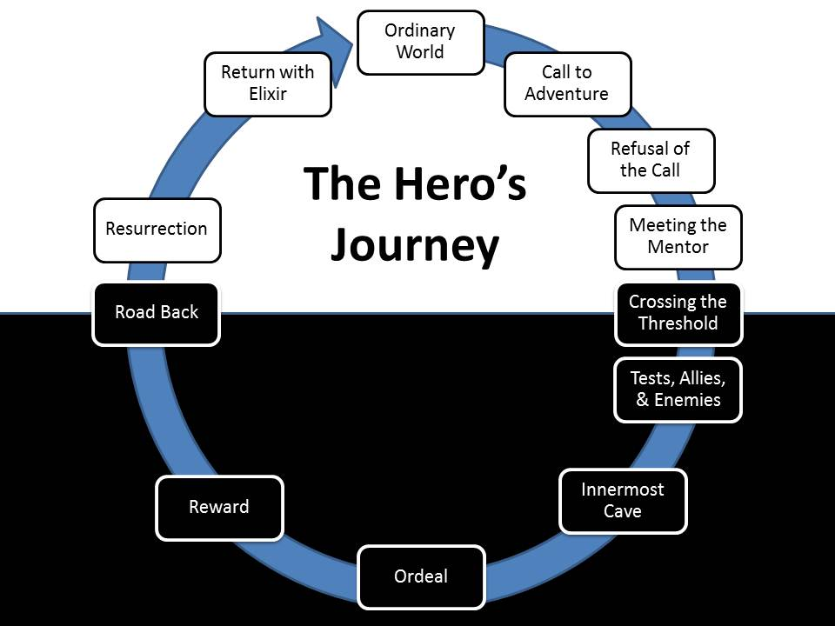

Slide 13
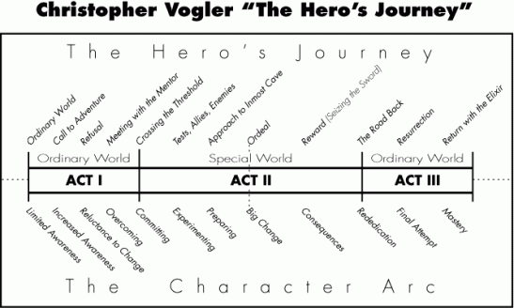
“The Hero’s Journey”

Slide 14
Spine & Story
Story theories help us to understand:
How characters in action make plot.
How characters who choose, take risks, & fail – change. In changing, they develop – for “good” or “bad”. How they change gives each a character arc.
Their arcs will not match. Their arcs might not match the narrative arc.

Slide 15
Kurt Vonnegut & the shapes of stories
https://www.youtube.com/watch?v=oP3c1h8v2ZQ
How do we draw the “shape of the story” of:
“Man in a hole”
“Boy Meets Girl”
“Cinderella”

Slide 16
Spine & Story in writing
Let’s draw a story:
  Little Red Riding Hood as we know it
How can we change the shape of the story to:
  Increase narrative drive?
How else could it be told?
  How does it change the story?
What other points of view are there?
  How do the points of view work together?

Slide 17
Spine & Story in Rewriting
How can we keep track of what we’re writing?
Find a system that helps you to see the structure:
Both design & narrative arc
Tools to keep track:
  Diagrams, maps for Spine, Characters, Structure etc.
  Index cards/Post-its
  Scrivener/Ulysses
  Excel

Slide 18
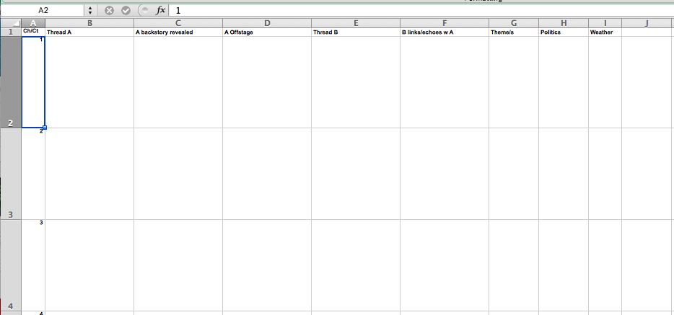
Emma Darwin: This Itch of Writing
Tool Kit: Novel Grid Plan – Excel
http://emmadarwin.typepad.com/thisitchofwriting/2010/05/help-yourself.html

Slide 19
Rewriting
What kind of feedback are you getting? And what do you do about it?
Story is unclear? Too complicated?
  Is the shape of your story right?
Not enough tension/not enough narrative drive?
  Change where you start on your spine?
Saggy middle? More tempo/pace needed?
  Add more highs and lows to spine & arc
Too much/too little plot/change/cause & effect?
  Are scenes more “and then” or “but then”?

Slide 20
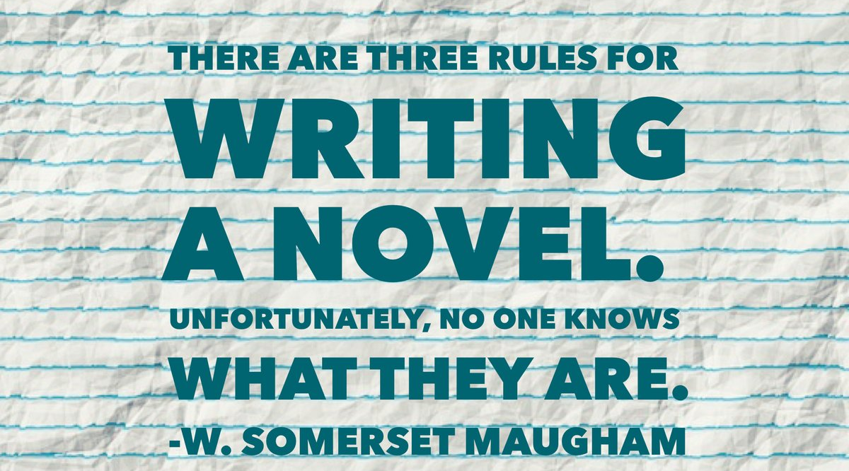
Remember…

